Slide 1

Introduction to Cloud Invoice
& Uniform Invoice Redemption app
Taipei City Revenue Service

Slide 2

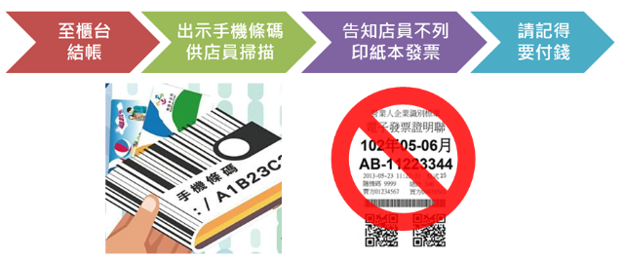


Slide 3
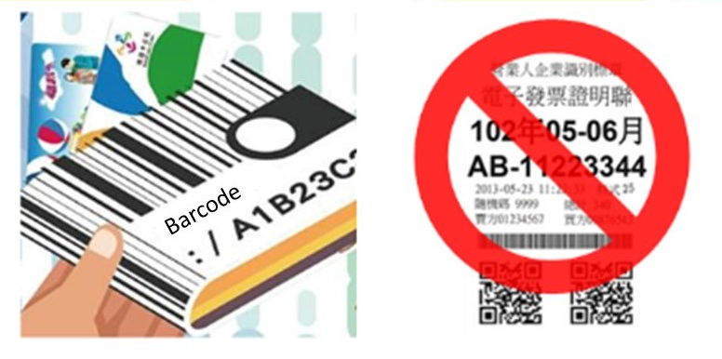
Check out at the counter
Show the mobile barcode to scan
Informed not to print paper invoices
Please remember to pay

Slide 4
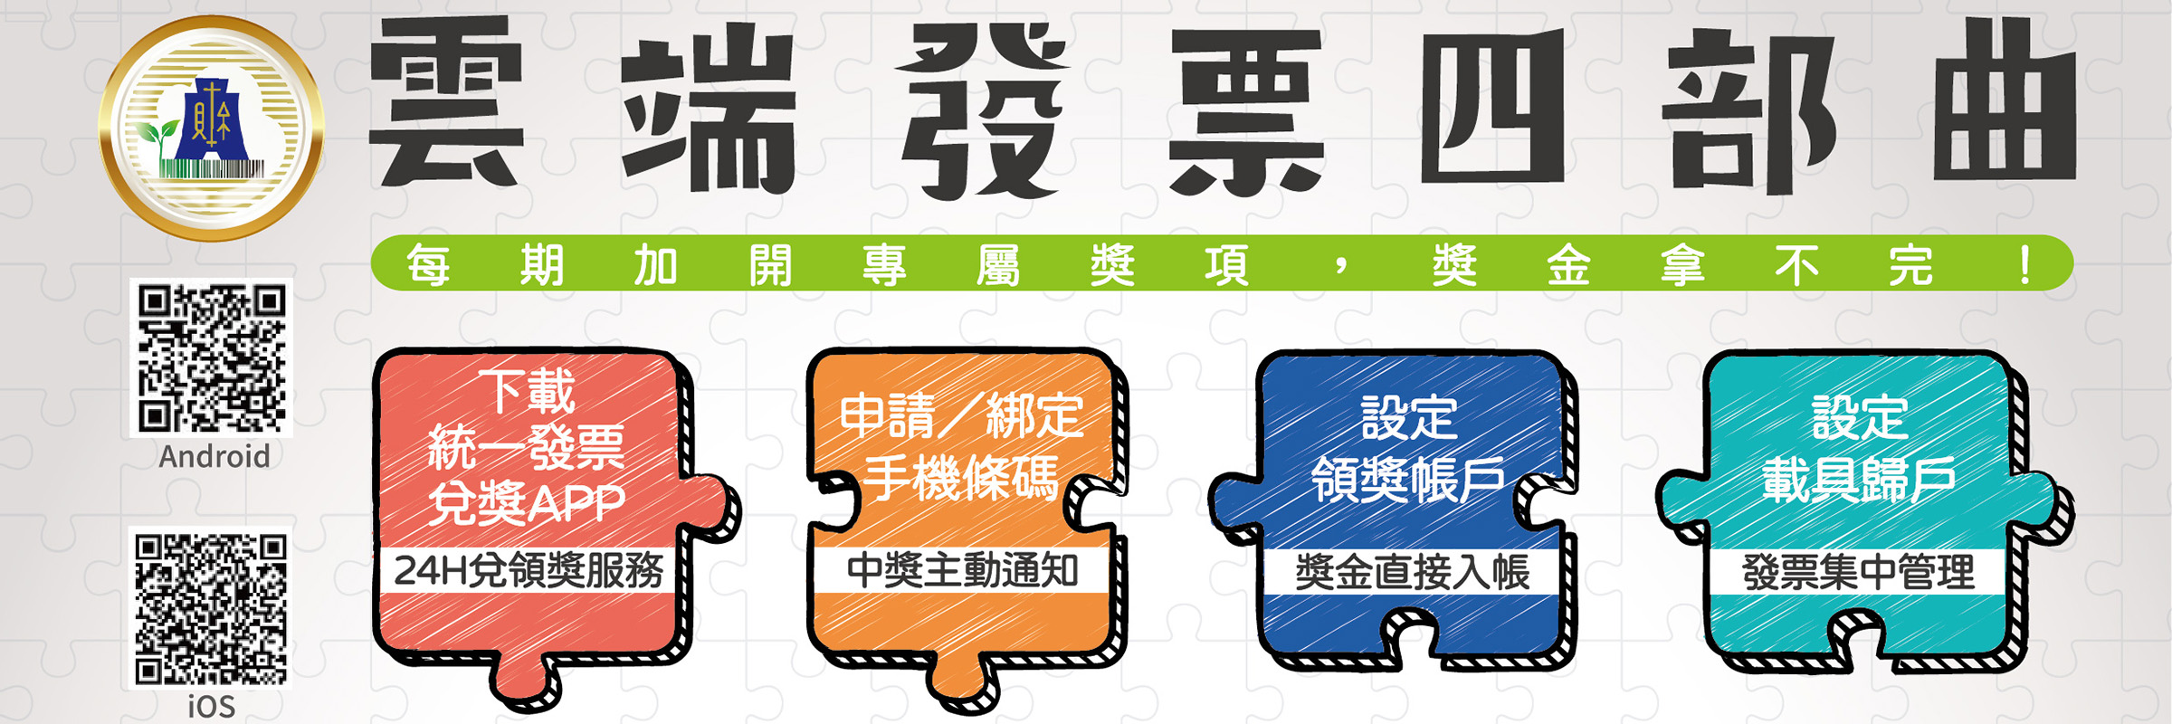
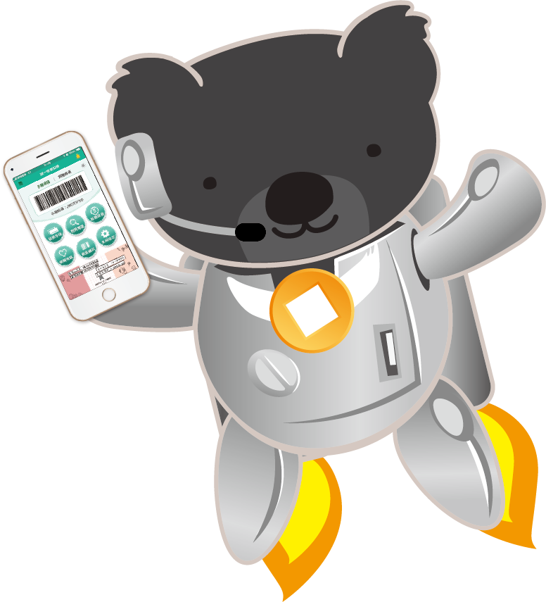

Slide 5
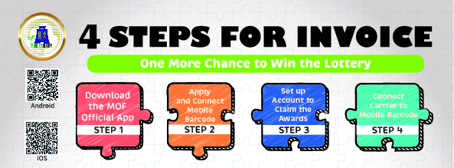

Slide 6
雲端發票四部曲
下載統一發票兌獎APP：
於Google play商店、iOS App Store搜尋「統一發票兌獎」（請認明有財政部LOGO的，才是正宗的統一發票兌獎APP）。
1
申請/綁定手機條碼：
打開「統一發票兌獎」APP，沒有手機條碼者，點選「註冊新帳號」申請。已有手機條碼者，輸入手機號碼及驗證碼登入即可完成綁定。
2

Slide 7
雲端發票四部曲
設定領獎帳戶：
登入APP，點選「系統設定」→「個人資料設定」(須再輸入驗證碼)，再點選下方「領獎資料」進行設定，就享有24小時免出門的線上兌領獎服務。
3
設定載具歸戶：
登入APP，點選「載具歸戶」→「新增載具」，即可將信用卡、悠遊卡、會員卡等載具與手機條碼作綁定。
4

Slide 8
4 steps for invoice
1
Download App
Search and download “Uniform Invoice Redemption App” using Google Play or iOS App store.
Application/ linking of Mobile Barcode
Open App
If you don’t have a mobile barcode, click “Sign up for a new account” to apply.
If you already have one, enter your mobile phone number and verification code to log in and complete the linking process.
2

Slide 9
4 steps for invoice
Set up Redemption Account
Log into the App. Click on “System Setup” → ”Personal Information Setup ” → “Prize Redemption Information” at the bottom to proceed with the setup.
3
Setup Carrier Consolidation
Log into the App. Click on “Carrier Consolidation” → “Add Carrier” to link your Credit Card, EasyCard, Membership Card with the mobile barcode.
4

Slide 10


Slide 11

Uniform-Invoice Winning Numbers
Special Prize
NT$10 million
Grand Prize
NT$2 million
First Prize
NT$200,000
Second Prize
NT$40,000
Third- Six Prize
NT$200-NT$10,000
Additional
Sixth Prize
NT$200

Slide 12
Special Prize for Cloud Invoice
30 Sets
NT$1million
1,6000 Sets
NT$2,000
100 thousand Sets
NT$800
1 million Sets
NT$500

Slide 13




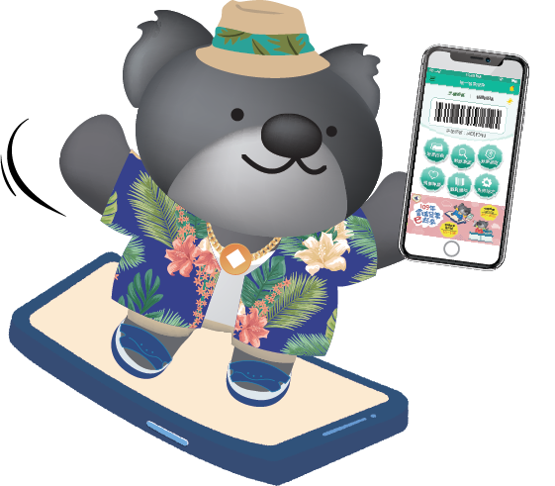
Like, follow and turn on the bell~

