Slide 1
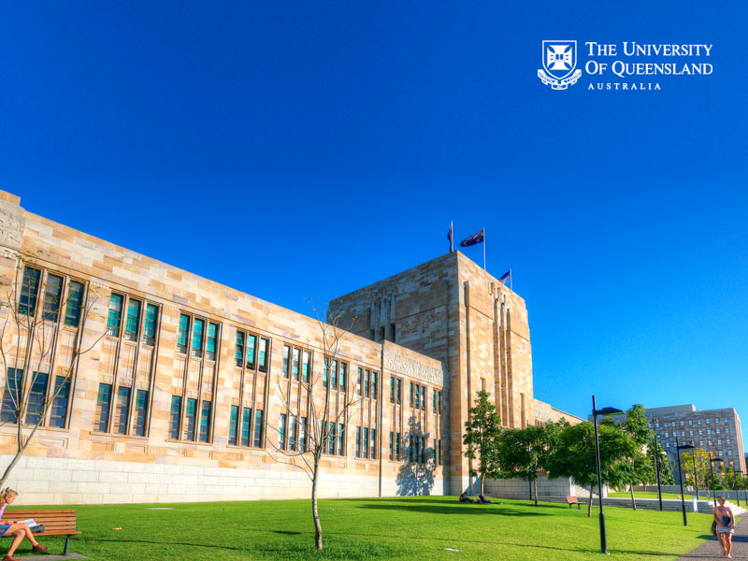
The icte-uq advantage
Experience the difference
Institute of Continuing & TESOL Education
The University of Queensland (ICTE-UQ)

Slide 2

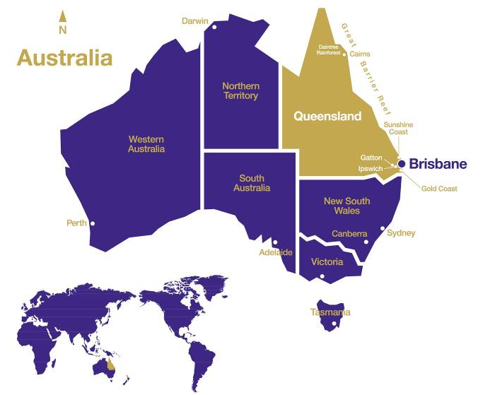
State capital of Queensland
Located between the Gold Coast (Surfers Paradise) and the Sunshine Coast
Population of 2.1 million
Sub-tropical climate
A ‘River City’ with an outdoors lifestyle

Slide 3
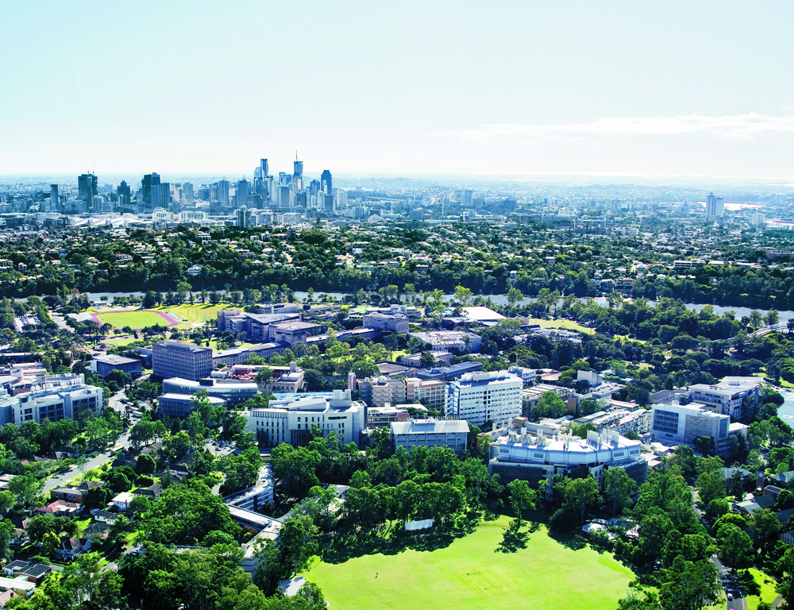
Experience
Life at UQ St Lucia, a world top 50 university campus (Times Higher Ed 2012)
114 hectares of riverside parkland
45,000+ students including 11,000+ international students from 135 countries
130+ student clubs and societies
World-class sporting, recreational and cultural facilities

Slide 4
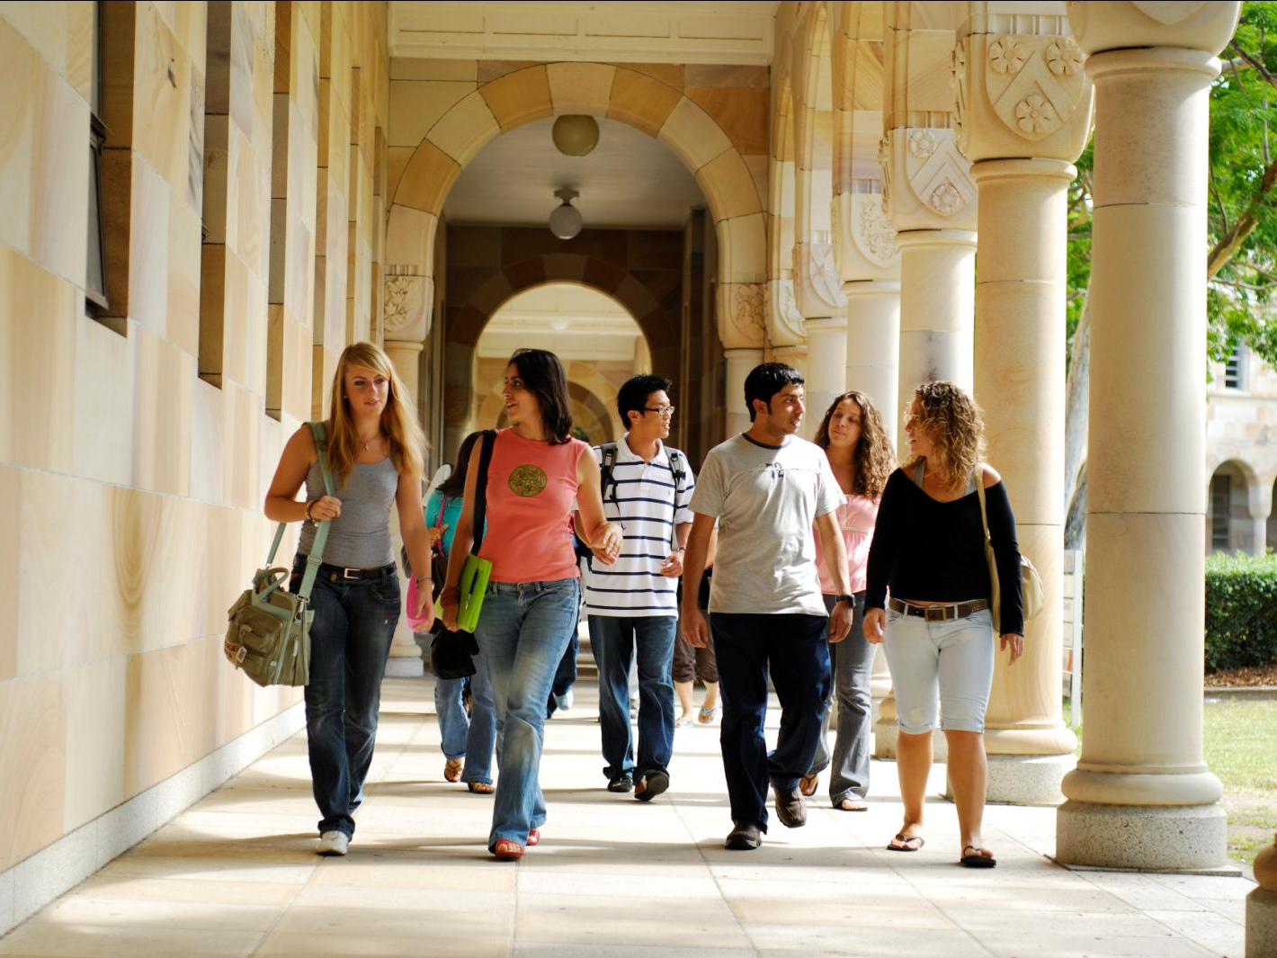
Experience
A highly awarded English language institute that is one of Australia’s oldest
Part of The University of Queensland, a university ranked amongst the top 1% of global universities by all major world ranking systems*
Established in 1981 as Queensland’s first English language institute
Winner of Australia’s top Education and Training export award in 2011 – the Australian Export Award
NEAS accredited and a founding member of English Australia
* Top 50 QS World University Rankings (2012), Top 100 Times Higher Education (2012), Top 100 (top 20 Asia Pacific) Shanghai Jiao Tong Academic Rankings of World Universities (2012)

Slide 5
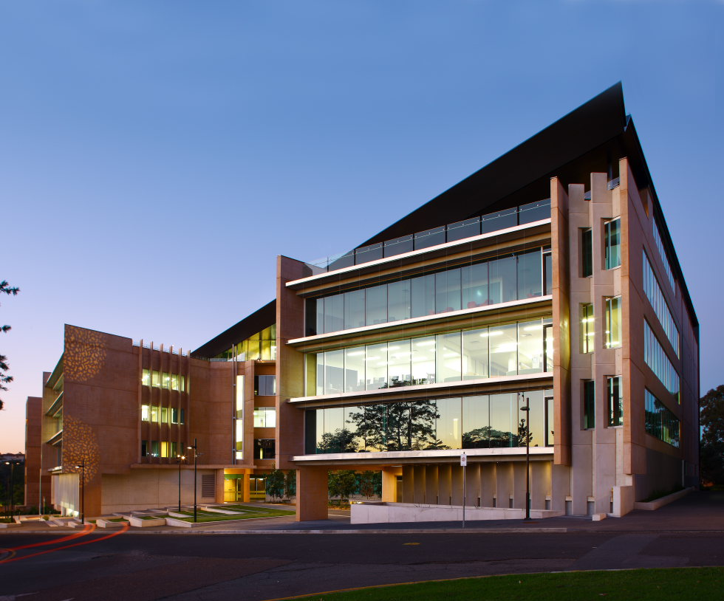
Experience
State-of-the-art facilities
ICTE-UQ is located in a new, purpose-built premises at UQ St Lucia
ICTE-UQ students learn in multimedia class and seminar rooms and use the latest electronic teaching and learning technology
ICTE-UQ students enjoy quality internet, computer and Learning Centre facilities

Slide 6
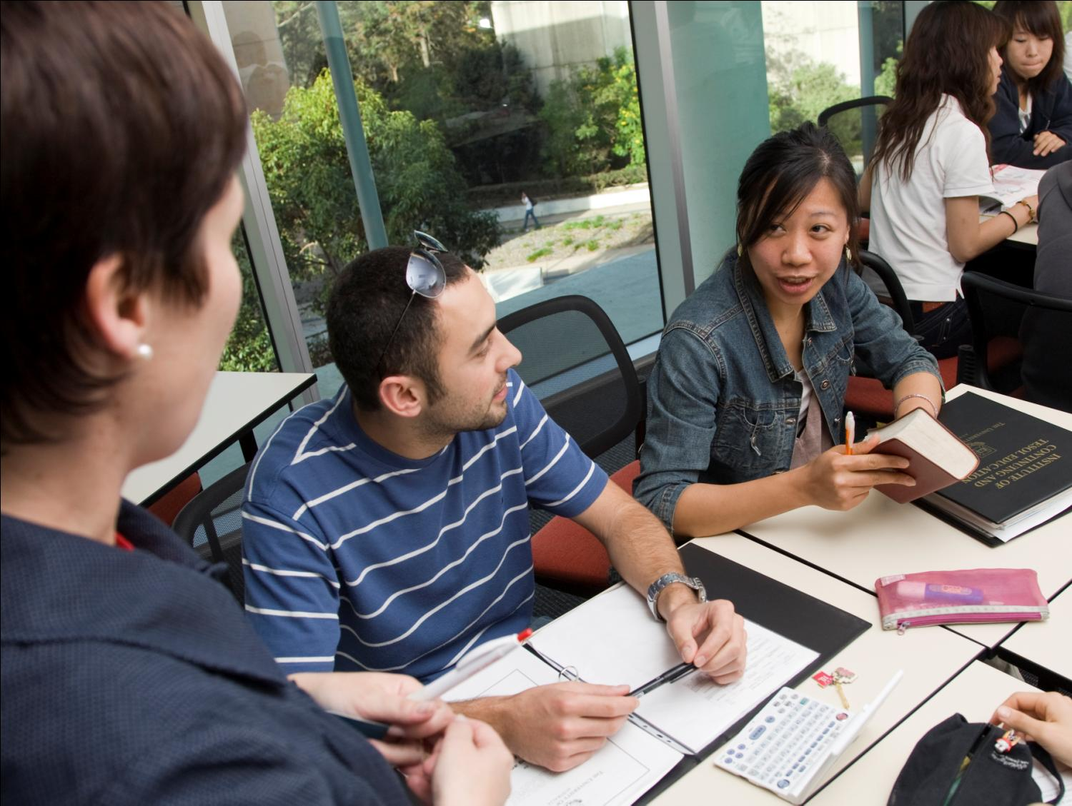
Experience
Quality courses and teaching
ICTE-UQ courses are taught in small, interactive classes of 14-18 students
ICTE-UQ teachers are qualified, experienced and supportive
ICTE-UQ courses do not use a textbook approach. We source the best materials from a range of sources and develop our own materials to make sure that our students enjoy the best possible learning experience

Slide 7
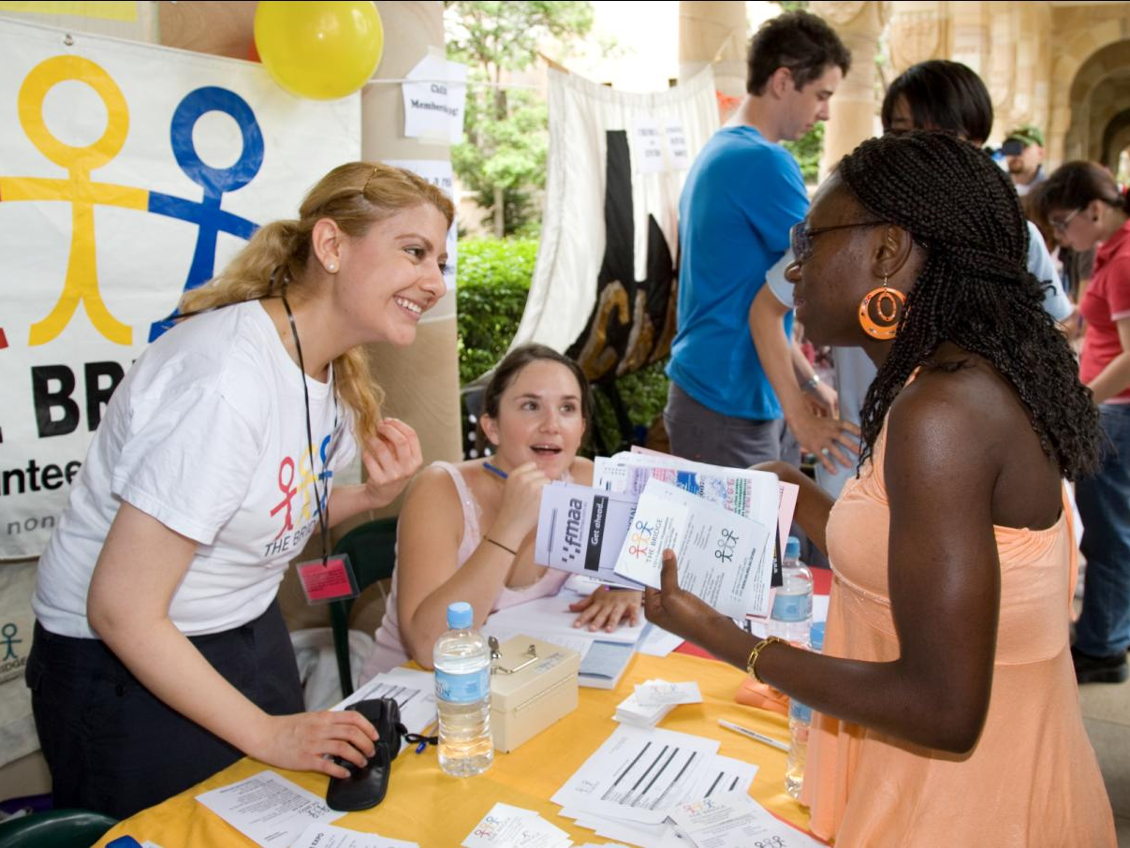
Experience
A dynamic, multicultural learning and social environment
Each session more than 500 students from over 35 countries choose to study at ICTE-UQ
There are lots of opportunities for ICTE-UQ students to make friends and get involved in social and sporting activities

Slide 8
Experience
Comprehensive course options
General English (7 levels)
English for Academic Purposes (2 levels)
English for International Business Communication (2 levels)
Advanced English Communication Skills
English for Specific Purposes: TESOL
English for Specific Purposes: Tourism & Hospitality
Go Global (English Language + Workplace Preparation + Professional Internship) program
English for Specific Purposes: Bridging English Program (for UQ degree program entry)
ICTE-UQ courses are delivered in five and ten week teaching sessions
All students are tested on their first day to determine their course and class level
All ICTE-UQ courses include 25 hours of face-to-face teaching each week

Slide 9
general english
Pre-elementary to Advanced
For students who want to improve their English language skills for social and work situations
Course content focuses on the development of communication skills with a balance of speaking, listening, reading and writing tasks
GE classes are topic based, interactive and use a mixture of course materials including books, television, radio, CDs, DVDs and computer software
Students learn through class activities, individual, pair and small group work
GE levels 4-7 include Options Classes. Students can choose from the following options:
  Academic or Business English
  Conversation
  IELTS Preparation
  Movies and Songs

Slide 10
general english
Sample Timetable
Monday | Tuesday | Wednesday | Thursday | Friday
9.00-10.45 Reading Skills | 9.00-10.45 Speaking, Listening, Reading & Writing Skills | 9.00-10.45 Options Class | 9.00-10.45 Speaking, Listening, Reading & Writing Skills | 9.00-10.45 Speaking, Listening, Reading & Writing Skills
Break
11.15-1.00 Writing Skills | 11.15-1.00 Speaking, Listening, Reading & Writing Skills | 11.15-1.00 Options Class | 11.15-1.00 Speaking, Listening, Reading & Writing Skills | 11.15-1.15 Speaking, Listening, Reading & Writing Skills
Break
2.00-4.00 Options Class | 2.00-3.45 Audio-Visual | 2.00-3.45 Speaking, Listening, Reading & Writing Skills | 2.00-3.45 Computer Assisted Learning | Free Afternoon

Slide 11


Homestay is a unique opportunity to:
Live with an Australian family
Learn about how Australians live and about Australian culture
Practice using English outside of the classroom
Homestay can be a very rewarding experience for students and families.
However, living with new people can sometimes be challenging… communication is the key.

Slide 12

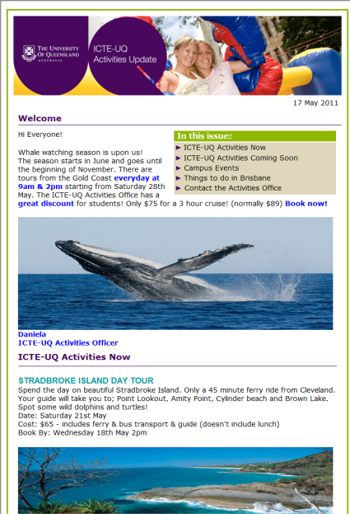
ICTE-UQ activities
Social, sporting, cultural and tourist activities
Free activities and student clubs
A monthly calendar of group activities
Activities for individual and small group bookings
To find out what’s happening at ICTE-UQ
Visit the Activities Office on Level 5
Like us on Facebook www.facebook.com/ICTEUQ
Read the Activities Calendar at www.icte.uq.edu/activities
Sign up to receive the Activities Update e-newsletter

Slide 13

contact us
Institute of Continuing & TESOL Education
The University of Queensland (ICTE-UQ)
www.icte.uq.edu.au
tesol.enrol@icte.uq.edu.au

